Slide 1
REAL-TIME KEYBOARD INPUT MONITOR (KEYLOGGER)
CAPSTONE PROJECT
Presented By:
Student Name- SERABIN ROJER A
Register no- 210821205099
College Name- Kings Engineering College
Department- Information Technology

Slide 2
OUTLINE
Problem Statement
Proposed System/Solution
System Development Approach
Algorithm & Deployment
Result (Output Image)
Conclusion
Future Scope
References

Slide 3
PROBLEM STATEMENT
Problem Statement: In today's digital age, where cybersecurity threats loom large, one of the significant concerns is the proliferation of keyloggers, stealthy software tools designed to monitor and record keystrokes on a user's computer without their knowledge. Keyloggers pose a severe threat to individuals and organizations as they can capture sensitive information such as passwords, credit card details, and other personal data, leading to identity theft, financial loss, and privacy breaches.

Slide 4
PROPOSED SOLUTION
The proposed solution is to develop a keylogger application using Python, which will allow users to monitor keyboard activities in real-time. Here's a breakdown of the proposed solution:
Graphical User Interface (GUI): The application will utilize the Tkinter library, which is a standard GUI toolkit in Python, to create a user-friendly interface. The GUI will include buttons for starting and stopping the keylogger, along with a label to display the status of the keylogger (e.g., running or stopped). This makes it easy for users to interact with the application.
Keyboard Event Capture: The pynput library will be employed to capture keyboard events such as key press, hold, and release. This library allows for monitoring and controlling input devices in Python. By listening to these events, the keylogger will be able to record all keystrokes made by the user.
Data Logging: The logged keystrokes will be stored in two formats:
Text File ('key_log.txt'): The raw keystrokes will be logged into a text file for easy access and viewing.
JSON File ('key_log.json'): The keystrokes will also be logged into a JSON file in a structured format. JSON (JavaScript Object Notation) is a lightweight data interchange format that is easy for both humans and machines to read and write.
Start and Stop Functions: The application will have functions to start and stop the keylogger. When the user clicks the "Start" button, the keylogger will begin capturing keyboard events. Conversely, clicking the "Stop" button will halt the keylogger and stop recording keystrokes.
Deployment: After development, the program can be made available for use on Windows, macOS, and Linux, among other platforms.

Slide 5
SYSTEM APPROACH
The "System Approach" section outlines the overall strategy and methodology for developing and implementing the rental bike prediction system. Here's a suggested structure for this section:
Tkinter: Used for creating the graphical user interface (GUI) of the application.
pynput: Employed to capture keyboard events such as key press, hold, and release.
JSON: Utilized for storing the logged keystrokes in a structured format.

Slide 6
ALGORITHM & DEPLOYMENT
Algorithm Selection: Real-time keyboard event capture is the main algorithmic component of this keylogger program. The Python pynput package, which offers tools for managing and monitoring input devices, is used to do this. Specifically, key press, hold, and release events are recorded using the Listener class from pynput. We can guarantee reliable and efficient keyboard activity monitoring without the need for sophisticated algorithms by using this library.
Data Input The stream of keyboard events produced by the user is the data input in the context of a keylogger. These actions consist of pushing, releasing, and holding down keys. By operating system-level keyboard listening, the pynput library obtains this input data. The program then processes each keyboard event in real-time.
Training Process: There is no formal training procedure for this keylogger program because it does not use predictive modeling or machine learning. Rather, the program records and immediately captures keyboard events as they happen. Thus, in this case, training data and a training procedure are not required.
Prediction Process: In the same way, this keylogger application does not have a prediction procedure because predictive modeling is not used. The recorded keyboard events are not used by the application to generate forecasts or judgments. Rather, it merely registers and captures these events in real time for examination or analysis at a later time.
Deployment: The keylogger application can be released for use on multiple platforms when it has been developed. The process of deployment entails packaging the application and enabling end users to install and run it. This can be done by sharing the source code with installation instructions or by making executable files for various operating systems. Deployment should also take privacy and security into account to guarantee that the application is used in an ethical and responsible manner.

Slide 7
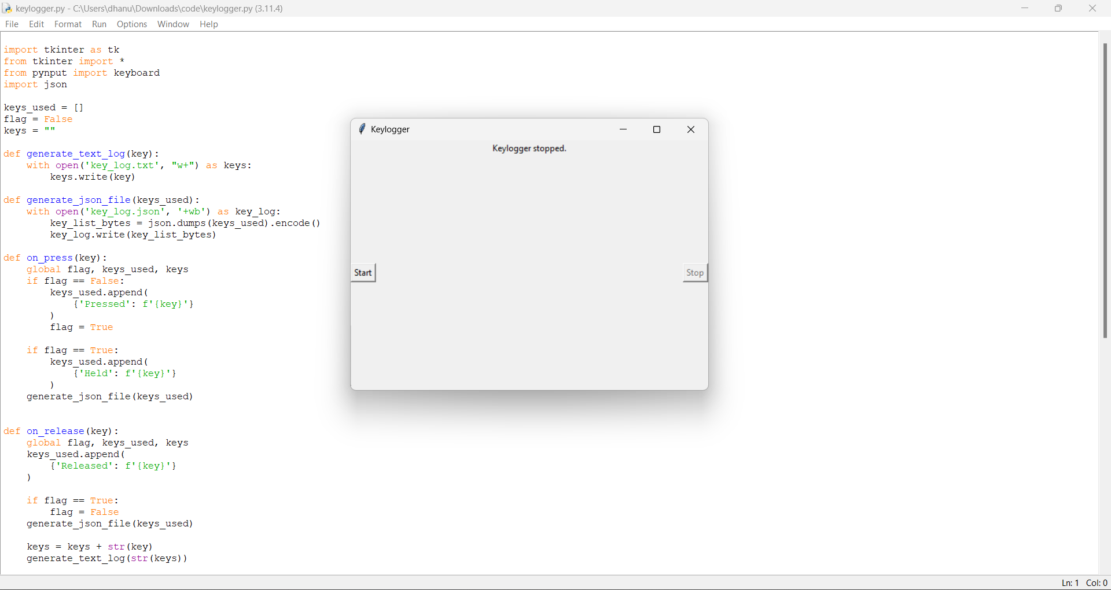
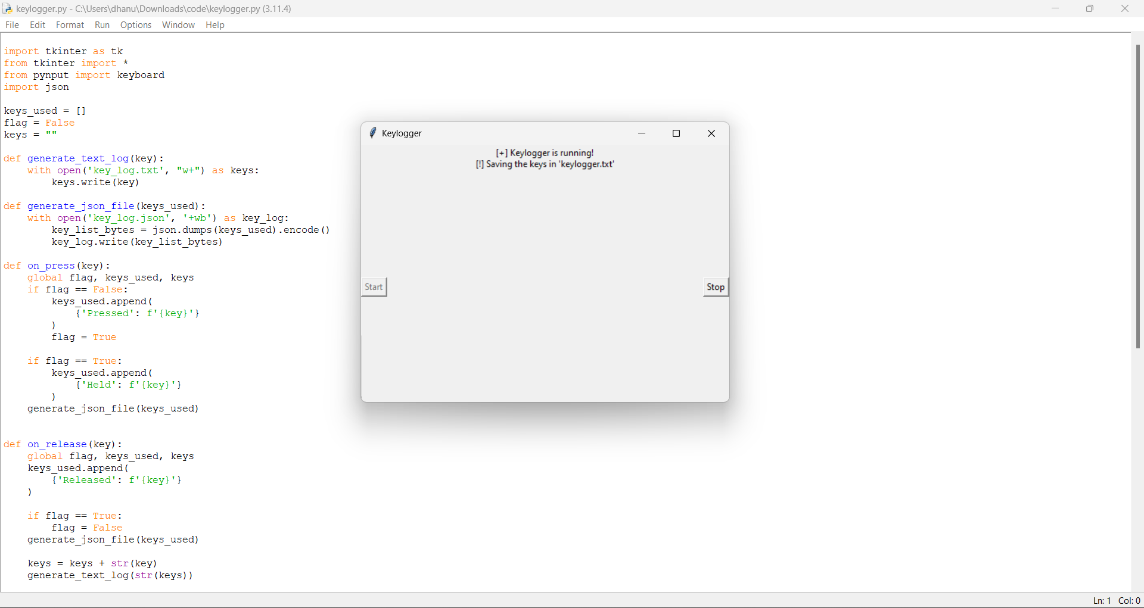
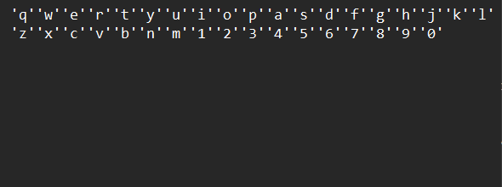
RESULT
The output picture displays the GUI interface, which includes buttons to start and stop the keylogger and a label that shows the keylogger's current state.

Slide 8
CONCLUSION
The keylogger application successfully captures keyboard inputs in real-time, providing users with a tool for monitoring keyboard activities. It offers a simple and intuitive interface for ease of use.

Slide 9
FUTURE SCOPE
. Add more information to your logs, like timestamps and application context, to improve its functionality.
Encrypt the logged data to protect privacy by implementing security.
Add functions for reporting and remote monitoring in order to conduct surveillance.
Investigate cross-platform and cross-device interoperability for increased use.
Improve performance and reliability by conducting more testing and optimization

Slide 10
REFERENCES
Documentation of Python libraries used (Tkinter, Pynput).
Online tutorials and forums for GUI development and keyboard monitoring in Python.
Official Python documentation for file handling and JSON serialization.

Slide 11
THANK YOU

